Slide 1
K18X001.00 FT2 station SOU17, SOU18 fail issue report
Prepare by: PE- Phuong
Date: Dec 24th 2021

Slide 2
Woofer Speaker balance left_400Hz check fail-1
1. Background and fail symptom:
- K18X001.00 MO control run improve audio noise*100pcs on 12/24/2021 find out 3pcs fail with error code SOU17: Woofer speaker balance left _400Hz, with defect rate 3/100=3%. And MO mass production*322pcs from 2021/12/24 to 2021/12/25 find out 7pcs error code SOU17: Woofer speaker balance left _400Hz, with defect rate 7/322=2.17%
2. FA status:
Step 1: Retest 5 times NG board fail SOU17 with fail value: 77.0925dB ➔ Result as table 1.
Woofer speaker balance left _400Hz Spec( 80 120)
Test time | 1 | 2 | 3 | 4 | 5
Value( Db) | 100.363783 | 100.388129 | 65.460104 | 101.963519 | 103.107357
Result | P | P | F | P | P
Table 1
Summary:
- NG board has test result unstable. Pass 4/5 times.

Slide 3
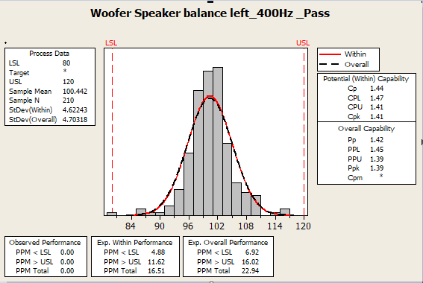
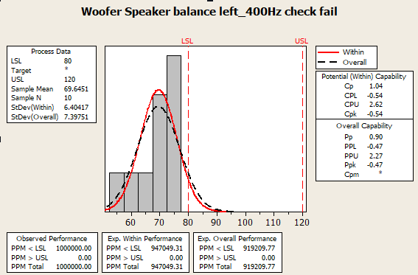
Woofer Speaker balance left_400Hz check fail-2
1. CPK analysis
Woofer Speaker balance left_400Hz CPK report:
- Check CPK of 10pcs fail and CPK pass of Woofer Speaker balance left_400Hz
Summary:
- For Pass CPK data, CPK = 1.41_level A+.
- For Fail CPK data , CPK = -0.54. Fail lower than spec value about 69.6451➔ Retest NG board pass normally.

Slide 4
Woofer Speaker balance right_400Hz check fail-1
1. Background and fail symptom:
- K18X001.00 MO control run improve audio noise*100pcs from 12/24/2021 to 12/25/2021 find out 1pcs fail with error code SOU018: Woofer speaker balance right _400Hz spec(80 120) , with defect rate 1/100=1%. And MO mass production*322pcs from 2021/12/24 to 2021/12/25 find out 12pcs error code SOU018: Woofer speaker balance right _400Hz, with defect rate 12/322=3.72%
2. FA status:
Step 1: Retest 5 times NG board fail SOU18 with fail value: 133.440848 dB ➔ Result as table 2.
Woofer speaker balance right _400Hz Spec( 80 120)
Test time | 1 | 2 | 3 | 4 | 5
Value( Db) | 99.008230 | 102.539595 | 77.006320 | 100.309520 | 77.120350
Result | P | P | F | P | F
Table 2
Summary:
- NG board has test result unstable. Pass 3/5 times.

Slide 5
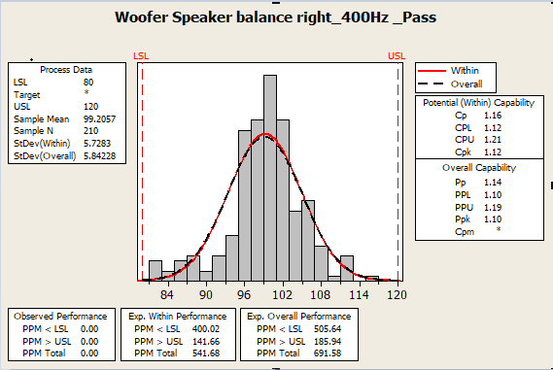
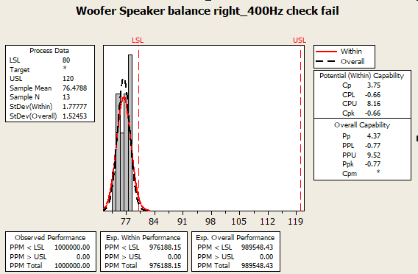
Woofer Speaker balance right_400Hz check fail-2
CPK analysis
Woofer Speaker balance right_400Hz check fail CPK report:
- Check CPK of 13pcs fail and CPK pass of Woofer Speaker balance right_400Hz
Summary:
- For Pass CPK data, CPK = 1.12 level B.
- For Fail CPK data, CPK = -0.66. Fail lower than spec value about 76.4788➔ Retest NG board pass normally.

Slide 6
Conclusion
1. Preliminary conclusion
As analyzed above this issue when testing the sound of Woofer speaker balance left and right at frequency 400Hz got unstable results.
2. Action
Short term
Retest NG board ➔ Pass normally
With very high defect rate: 4% with MO control run 100pcs, and with MP defect rate: 5.9%
Long term
- Suggest change spec from (80 120)db to (60 120)db to improve this issue at FT2 station.
- Need RD: Fu-chiang co_work to find out action improve this issue at FT2 station.
Onwer: RD: Fu-chiang, Sean, TE: Allan, PE: Phuong

